Slide 1
Adult Spring Chinook Salmon Passage and Migration Behavior through the Lower Snake River (gas cap spill evaluation)
Daniel Deng, Jayson Martinez, Tao Fu, Robert Mueller, Brett Pflugrath, Christopher Grant, Ryan Harnish, Xinya Li, Scott Titzler, Kenneth Ham, Xinming Lin, Huidong Li

Slide 2
Outline
Study Objectives
Fish Collection and Tagging
Detection Arrays
Controlled Testing
Preliminary Results
Conclusions

Slide 3
Study Objectives
Evaluate tailrace movements, passage, and fallback of adult Chinook salmon at Little Goose Dam (LGS) in relation to increased spill levels
  Metrics for the consequence of spill include:
    Tailrace behavior and movement
    Behavior in relation to operations and hydraulic conditions
    Delay/holding tailrace locations
    Preferred entrances into the adult fish ladder
  Calculate relevant adult passage metrics to compare against the previous radio telemetry results by Clabough et al. (2014) and Jepson et al. (2009).
A component of this study included using the data collected to conduct a post-construction evaluation of a new adult ladder passage temperature reduction system.

Slide 4
Fish Collection and Tagging
Fish Collection and Tagging

Slide 5
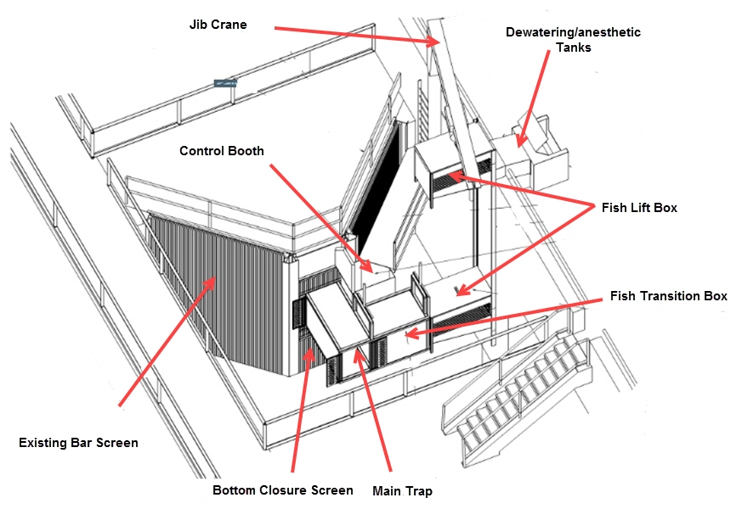
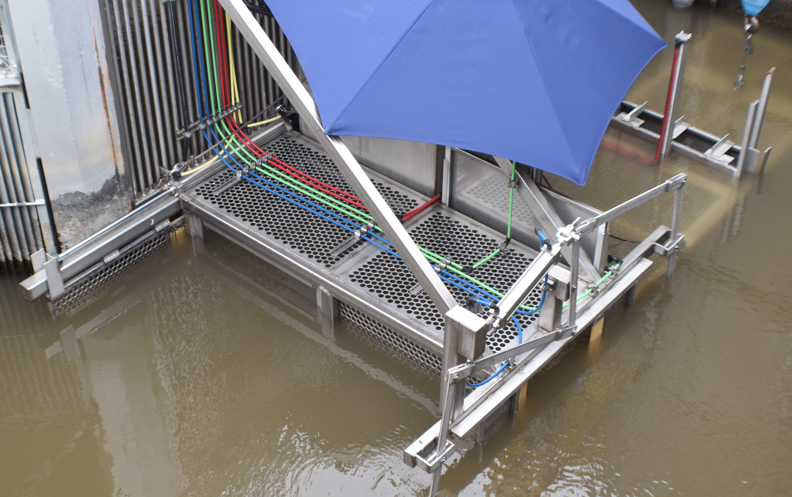
Fish Trap
Modified from USACE Walla Walla District

Slide 6
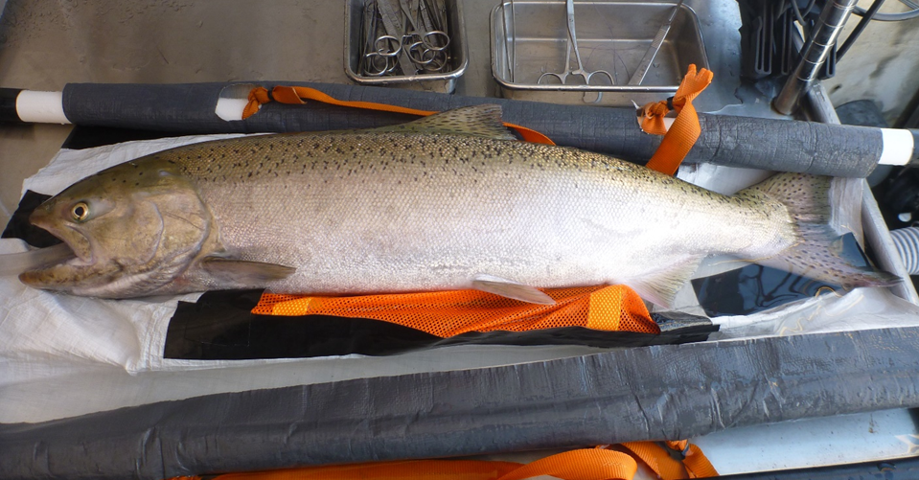
Fish Tagging Summary
400 Fish tagged
  Both AT and PIT
April 26th – June 6th
1.3% of the run
Released same day as tagging
~25% unclipped fish

Slide 7
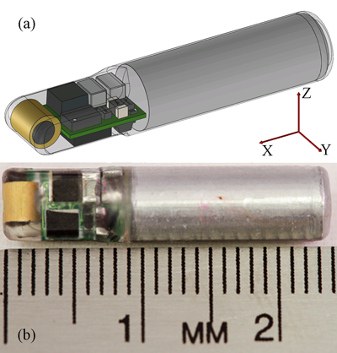
“Sturgeon” Tag
(Small long-life acoustic transmitter)
Dimension: 24.2 mm x 5.0 mm
Dry Weight: 0.7 g
Wet Weight: 0.2 g
Volume: 429 mm³
Source Level: 161 or 163 dB at zero degrees
Configurable source level, pulse rate interval, & tag code.
Tag Life:
  30 days at 163 dB and 2-s pulse rate interval
  365 days at 161 dB and 15-s pulse rate interval.

Slide 8
Detection Arrays
Detection Arrays

Slide 9
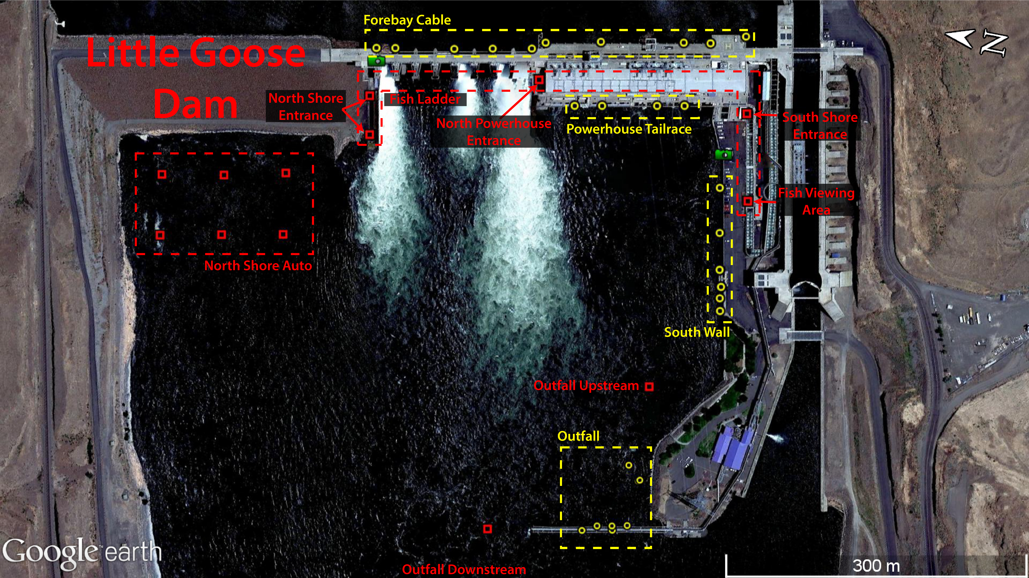
LGS Deployment

Slide 10
Autonode and PIT Arrays

Slide 11
Controlled Testing
Controlled Testing

Slide 12
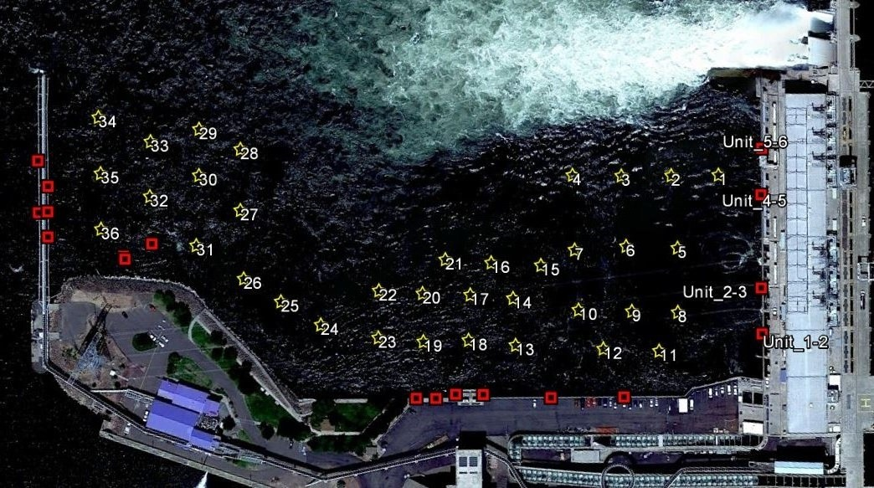
Error Analysis - 32 Test Locations
River Flow

Slide 13
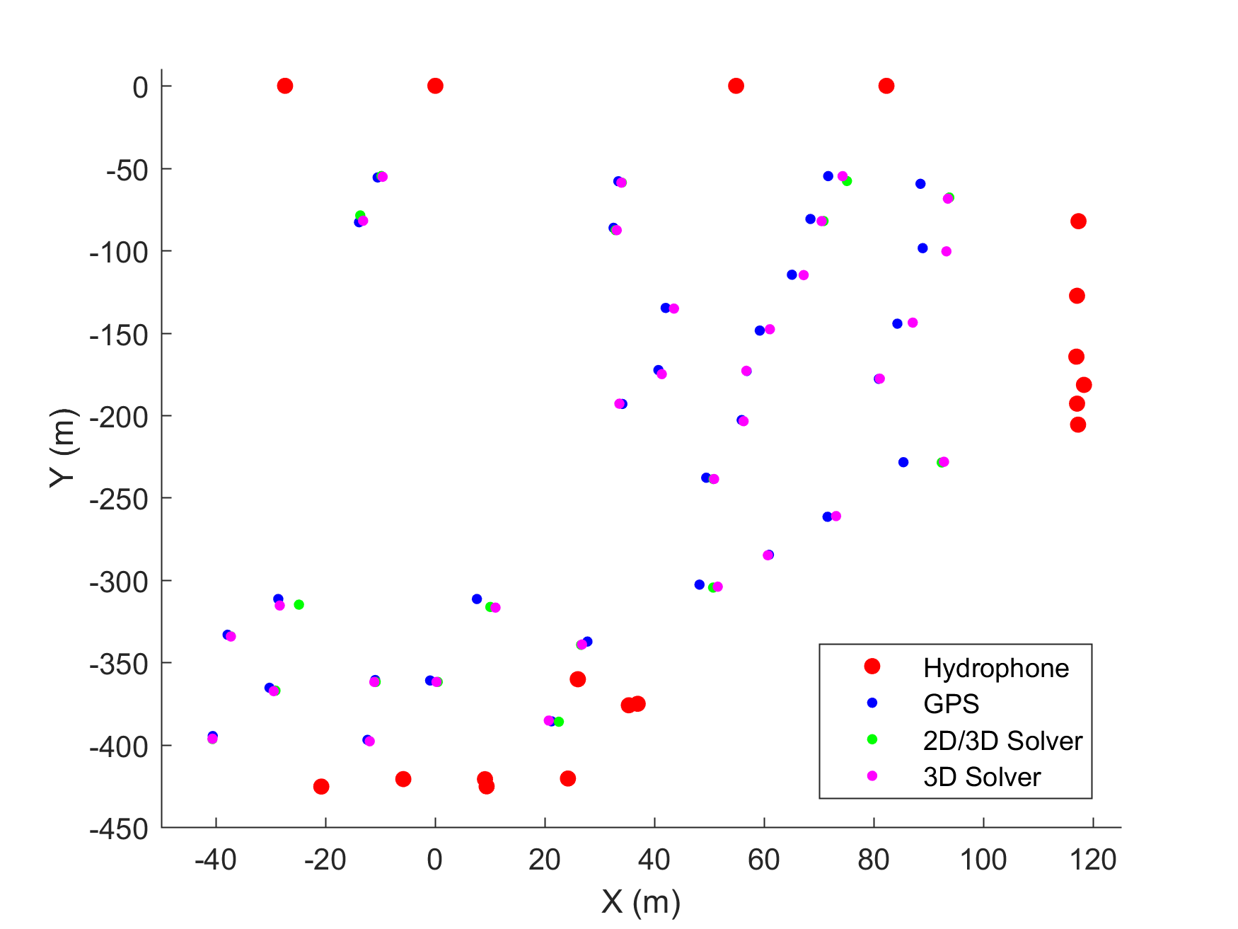
New 2D/3D Hybrid Solver
3D: Requires decodes from at least 4 hydrophones, produces X,Y,Z
2D: Requires decodes from at least 3 hydrophones, produces X,Y
Current solver, 3D only
New Solver, 2D and 3D hybrid tracks
  More Tracks
  Similar Accuracy along X and Y

Slide 14
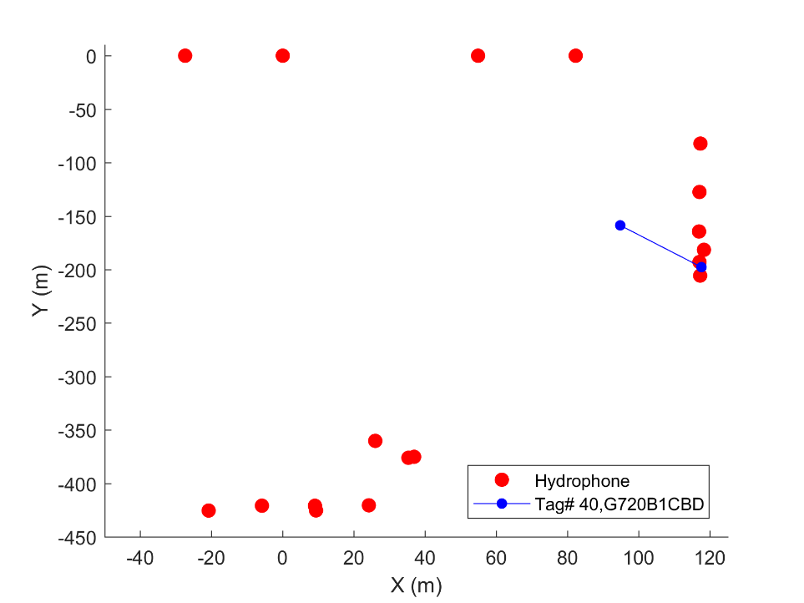
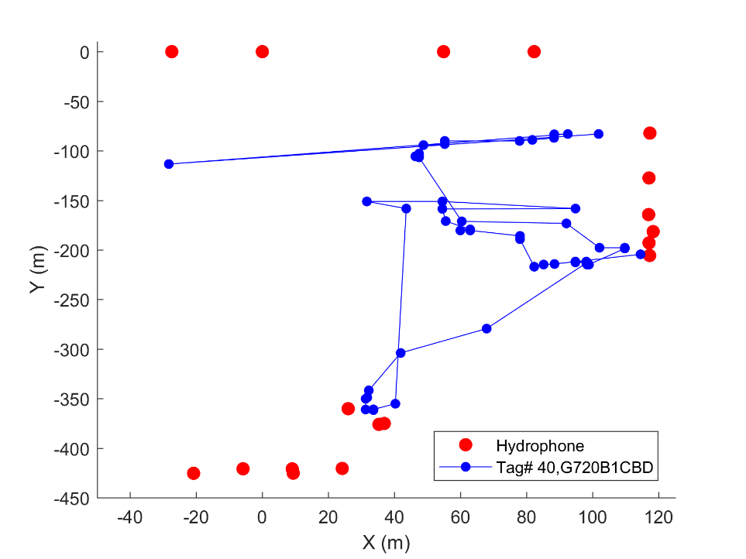
Improvement: New 2D/3D Hybrid Solver
3D Solver
2D/3D Hybrid Solver
LGS18_Block02-04_Adult_Fish | 3D | 2D/3D Hybrid | Diff
# Tag has Track | 140 | 212 | 72 (51%)
total # of Track | 3206 | 14578 | 11372 (355%)

Slide 15
Preliminary Results
Preliminary Results

Slide 16
Detection and Tracking Summary in Different Regions
 | Number of Detected Fish | Median Number of Detections | Number of Tracked Fish | Median of Tracked Locations
LGS Tailrace Cabled /LGS Tailrace Auto | 369 | 7325 | 345 | 128
LGS Tailrace Cabled | 311 | 162 | 228 | 13
LGS Tailrace Cabled - Outfall | 147 | 36 | - | -
LGS Tailrace Cabled - South Wall | 300 | 141 | - | -
LGS Tailrace Cabled - Powerhouse | 167 | 18 | - | -
LGS Tailrace Auto | 331 | 8397 | 316 | 123
LGS Tailrace Auto - North Shore | 330 | 8387 | 316 | 123
LGS Tailrace Auto - Downstream Outfall | 59 | 18 | - | -
LGS Tailrace Auto - Upstream Outfall* | - | - | - | -
LGS Forebay Cabled | 342 | 166 | 282 | 18
LGR Forebay Cabled | 340 | 910 | 325 | 59
* No valid data was collected

Slide 17
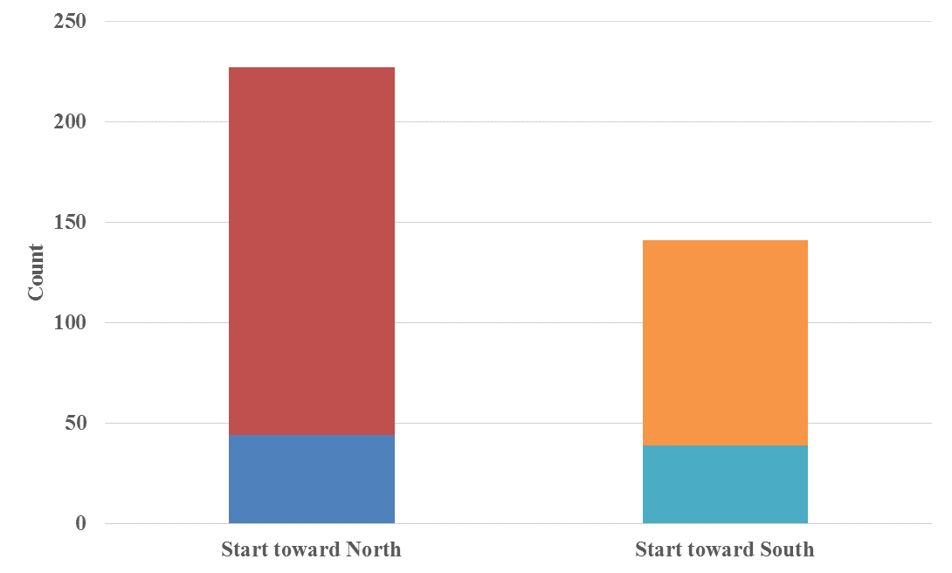
First LGS Tailrace Detections and Fish Ladder Entrance
First LGS Tailrace Detections
Outfall | South Wall | Powerhouse Tailrace | North Shore Tailrace | Total
40 | 90 | 10 | 229 | 369
11% | 24% | 3% | 62%
50%
First LGS Fish Ladder Entrance
Entry Location** | 2008 | 2013 | 2018
South Powerhouse | 138 (48%) | 170 (64%) | 163 (47%)
North Powerhouse | 25 (9%) | 44 (16%) | 3 (1%)
North Shore | 123 (43%) | 53 (20%)* | 182 (52%)
Unknown |  |  | 1 (0.25%)
Total | 286 | 267 | 349
* Reported as unknown because the north shore was unmonitored during study.
** The first fish ladder entry detection location for each fish: based on the detection of the receivers at each entrance inside the fish ladder.
27.5%
12%
11.5%
Staying near Northshore before entering fish ladder
Staying near Southshore before entering fish ladder
Swim between regions before entering fish ladder

Slide 18
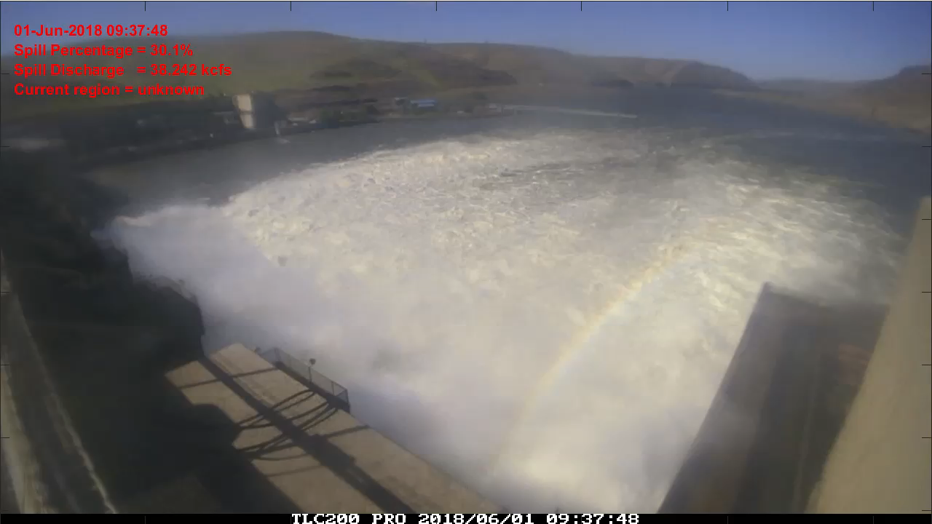
Fish Track and Time Lapse Video

Slide 19
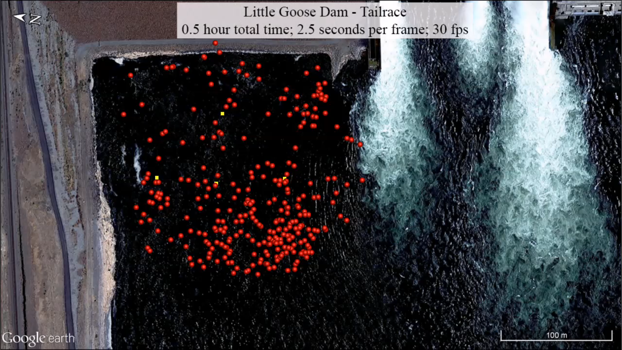
North Shore Fish Tracks

Slide 20
Fish Passage Detections at Each Dam
Location | 2008 | 2013⁽¹⁾ | 2018 | 2018 (PIT)
Release | 360 | 300 | 400 | 400
Passed Lower Monumental |  | 264 (88.0%) | 387 (96.8%)⁽²⁾ | 360 (90.0%)
At Little Goose | 290 (80.6%) | 261 (87.0%) | 369 (92.3%) ⁽³⁾
Passed Little Goose | 287 (79.7%) | 256 (85.3%) | 367 (91.8%) ⁽⁴⁾ | 353 (88.3%)
Passed Lower Granite |  | 252 (84.0%) | 364 (91.0%) ⁽⁵⁾ | 354 (88.5%)
(1) Includes both RT and PIT
(2) Detected by LMN PIT or any LMN upstream PIT/Auto/Cabled arrays
(3) Detected by either LGS tailrace cabled array or LGS near dam auto nodes
(4) Detected by any LGS upstream arrays (LGS PIT, LGS FL exit, LGS forebay cabled, LGR PIT, or LGR forebay cabled array)
(5) Detected by either LGR forebay cabled array or LGR PIT detectors

Slide 21
Median Fish Passage Times
From first tailrace detection to… | 2008* | 2013 | 2018
First fishway entry detection (hrs) | 7.3/11.8/5.5 | 7.4 | 13
Exit to LGS forebay (hrs) | 14.5/21.6/11.5 | 19.7 | 25.0**
First fishway entry to ladder top (hrs) | 3.5/2.9/3.1 |  | 3.2
* Separated by 3 different spill patterns (Alternate, Bulk, Uniform)
** From first tailrace detection time to the first fish ladder exit detection time

Slide 22
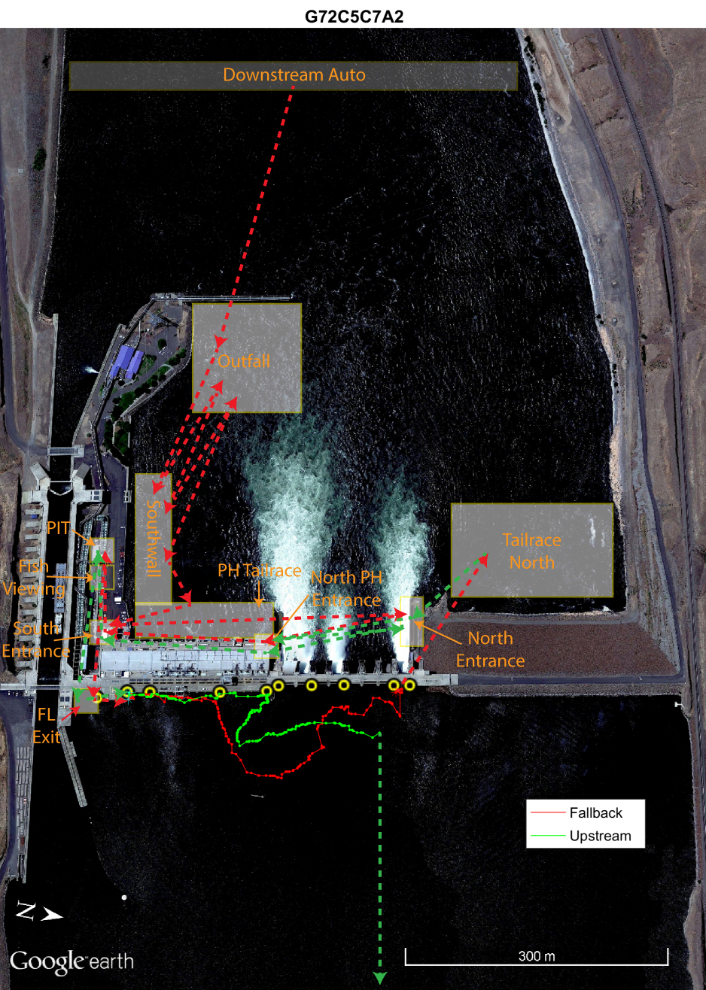
Fallback at LGS
# of fish that passed LGS | 367 | -
# of fallback fish | 36 | 9.8%
# of fallback events | 44 | 12.0%
# of fallback events through SP | 38* | 86.4%
# of fallback events through PH | 6** | 13.6%
upstream LGR | 32 | 88.9%
between LMN and LGS | 3 | 8.3%
downstream MCN | 1 | 2.8%
* 25 through ASW and 13 through regular spillway bays ** Three of the fish that had fallback through the PH were detected by the JBS PIT
 | 2008 | 2013 | 2018
Fallback percent* | 3.9% | 7.5% | 9.8%
Fallback rate** | 5.3% | 7.9% | 12.0%
*unique fish that fell back/unique fish passed dam
**fallback events/unique fish passed dam

Slide 23
Fallback Time After Exiting Fish Ladder
Amount of time from 1st forebay detection to the last forebay detection prior to fallback.

Slide 24
Total Flow and Spill Percentage at Time of Fallback Event

Slide 25
Final Fate
 |  | Count | Percentage
Downstream ICH | Lower Columbia River | 11 | 2.75%
 | Walla Walla River | 1 | 0.25%
 | Upper John Day River | 1 | 0.25%
 | Upper Yakima River | 1 | 0.25%
Between ICH and LMN | Snake River | 2 | 0.50%
Between LMN and LGS | Snake River | 10 | 2.50%
 | Tucannon River | 6 | 1.50%
Between LGS and LGR | Snake River | 5 | 1.25%
Upstream of LGR |  | 357 | 89.25%

Slide 26
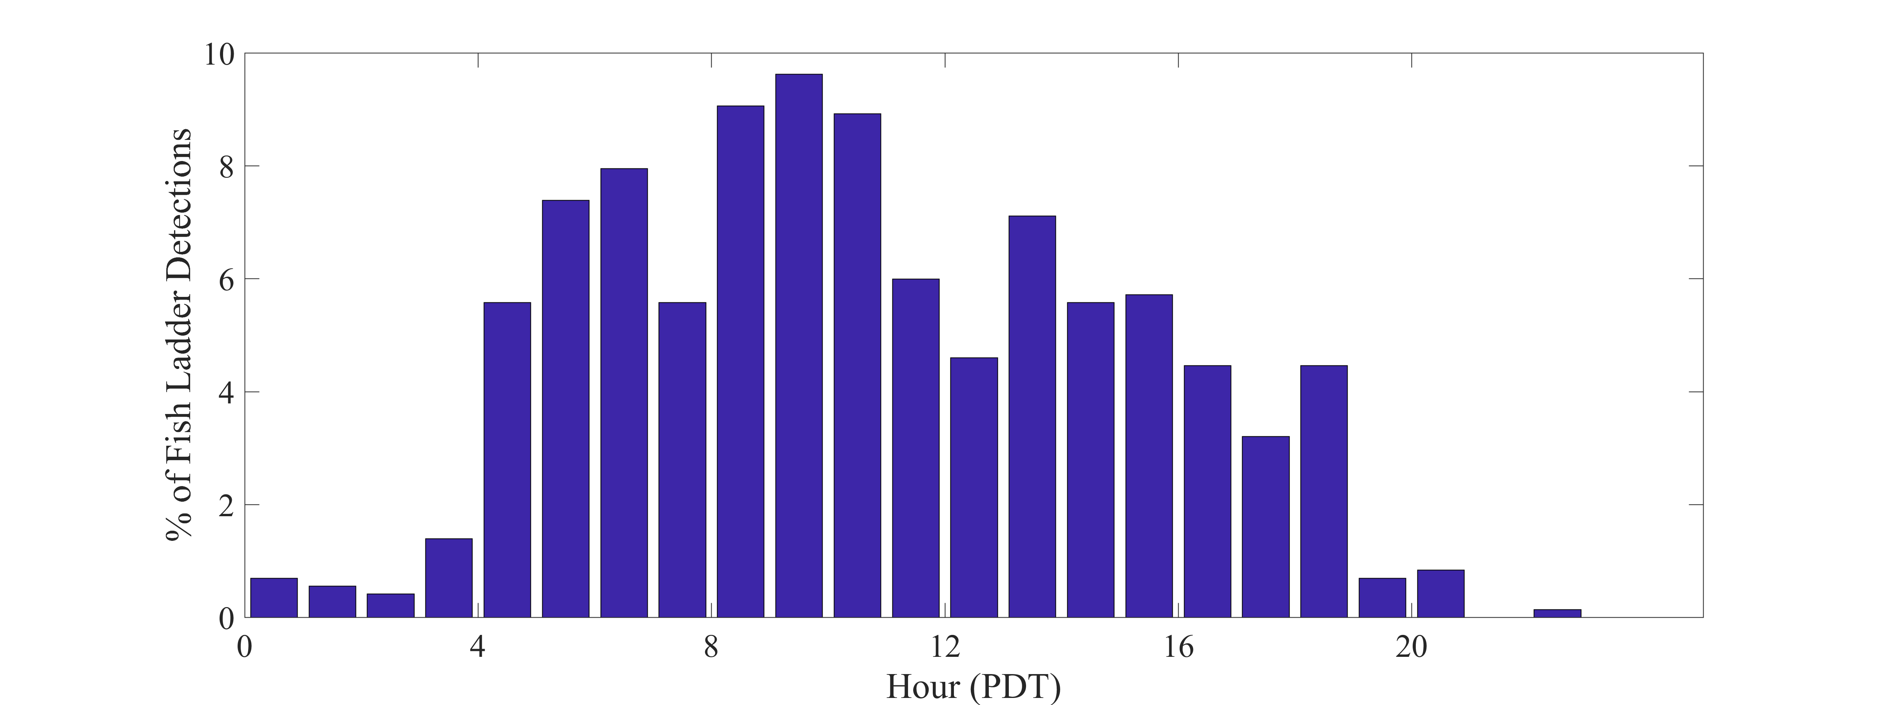
Hourly Distribution of Adult Fish Entering Fish Ladder
Fish prefer to enter fish ladder during the day time
  95.26% of fish entered fish ladder after 4 am and before 7 pm.
2008 study also found that fish were most active during daylight hours and least active at night.

Slide 27
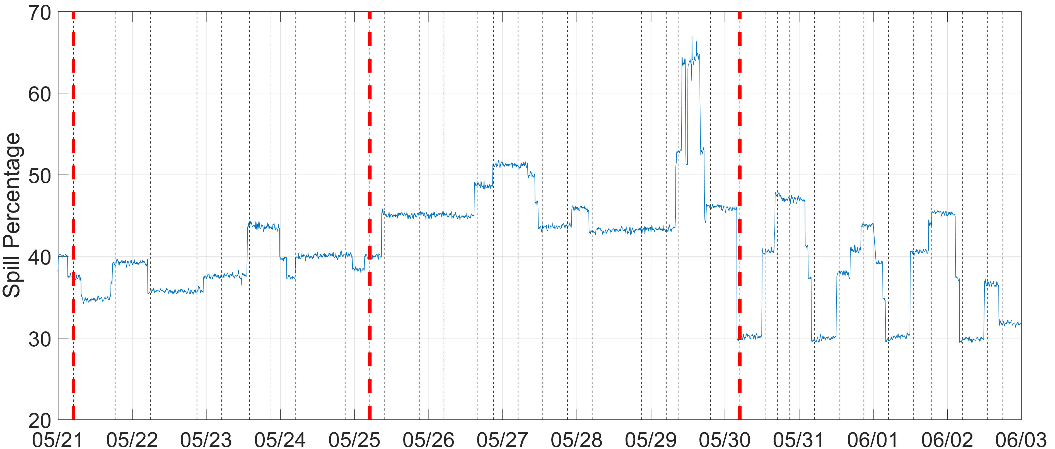
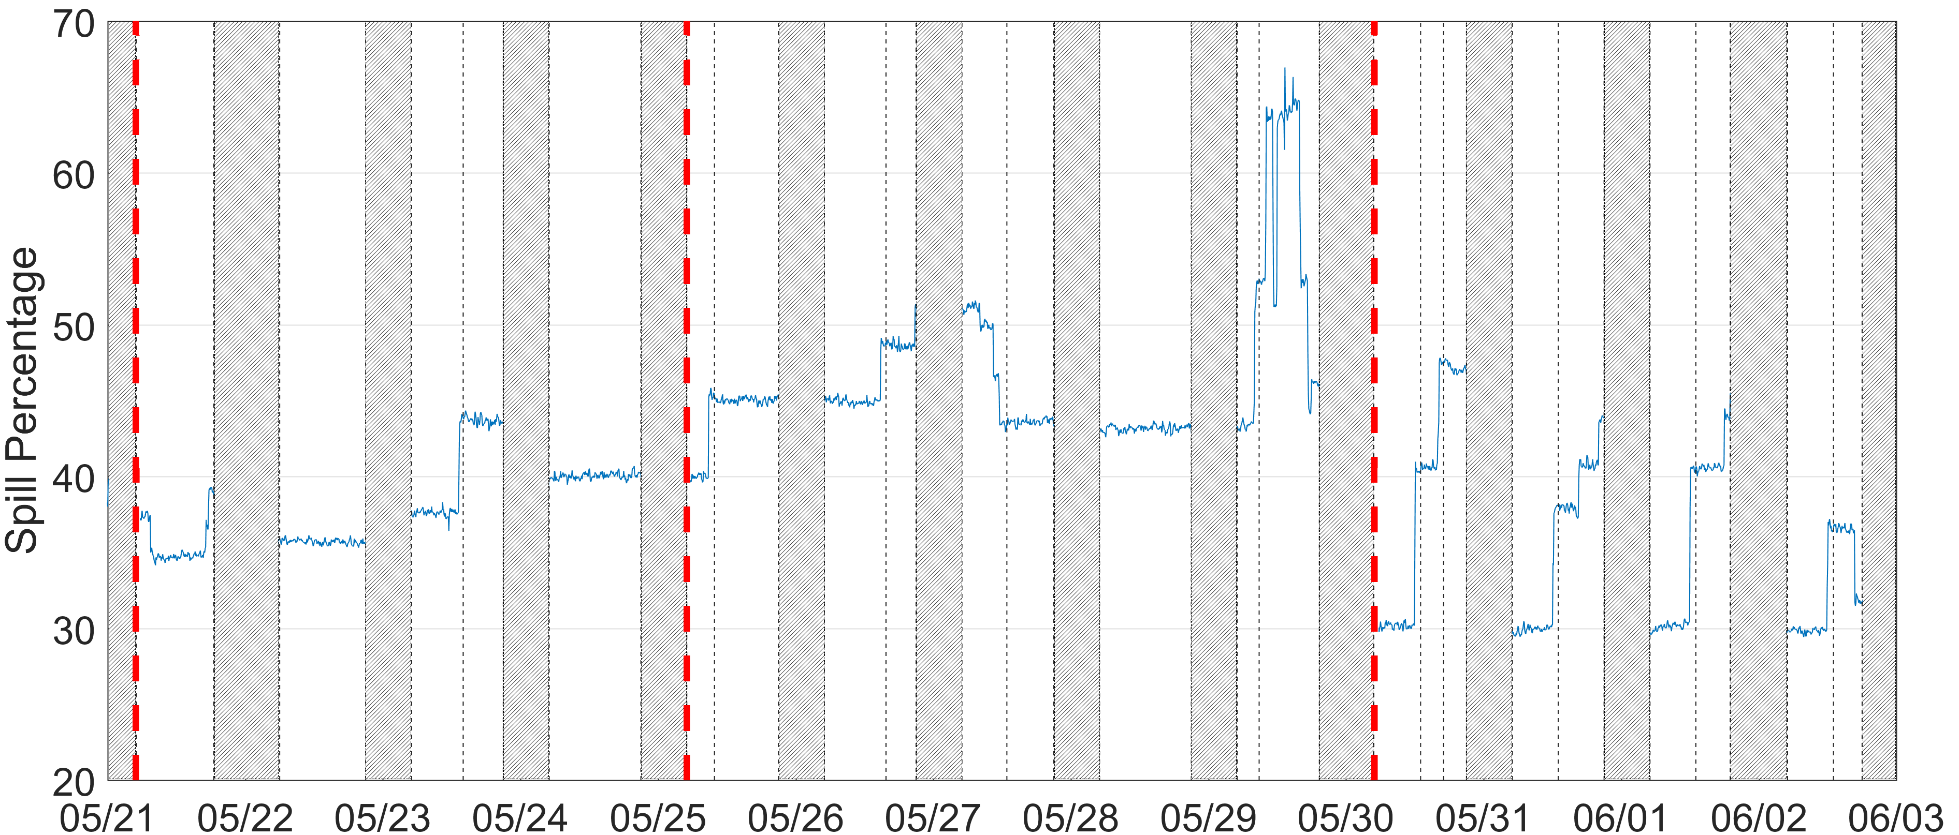
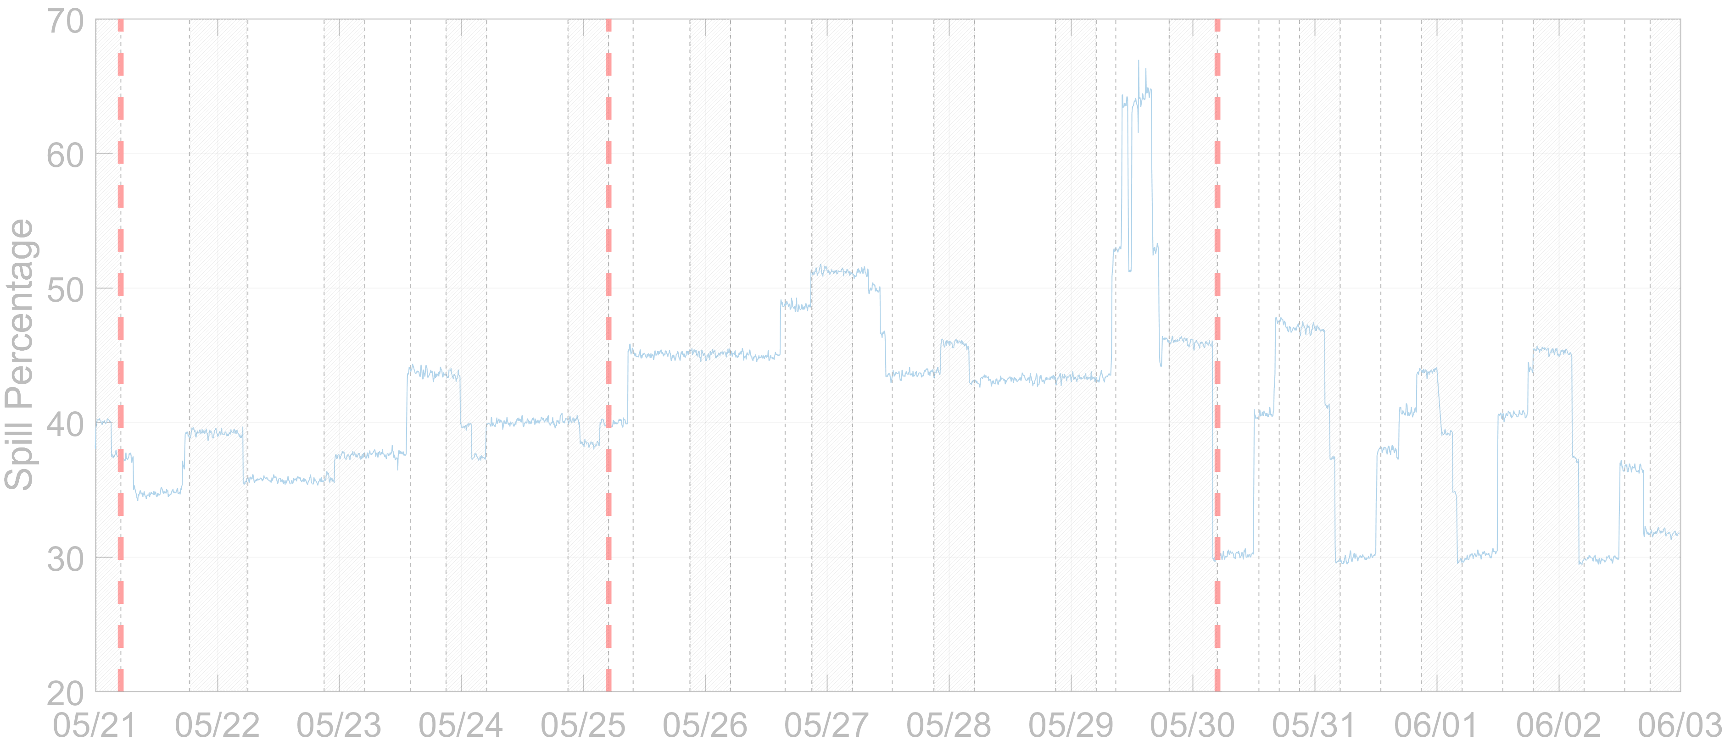
Spill Level and Proportion of Fish in the Tailrace Entering Fish Ladder from 5/21 to 6/3
Results were calculated for day time spill period (4 am to 8 pm PDT).
From 5/21 – 5/24, when spill level was 35-40%, about 30-50% of fish in the tailrace entered fish ladder.
From 5/25 – 5/29, spill level was at 45% and above and less than 20% of fish in the tailrace entered the fish ladder.
From 5/30 - 6/3, special 30% spill treatment was applied.
  Over 40% - 65% of fish in the tailrace entered fish ladder during 30% spill treatment within these 4 days.

Slide 28
Spill Level and Proportion of Fish in the Tailrace That Entered North Fish Ladder and South Fish Ladder from 5/21 to 6/3
From 5/21 - 5/29, no clear trend of fish entering ladder through South and North Entrance
From 5/30 - 6/3, during the 30% spill treatment periods, more fish first entered through North Shore Entrance than South Shore Entrance.

Slide 29
Fish Movement in Tailrace Relative to Spill Operations
A higher percentage of fish were first detected in the north shore than the south shore region within each of the spill treatments
  For higher spill percentages a larger percentage of fish were along the north shore
For fish that were first detected in the north shore region at lower spill percentage, about half stayed in the north shore region and the other half moved downstream or to the south shore
  As the spill percentage increased lower percentage of fish moved to other regions
At higher levels spill percentage, a lower percentage of fish entered the ladder

Slide 30
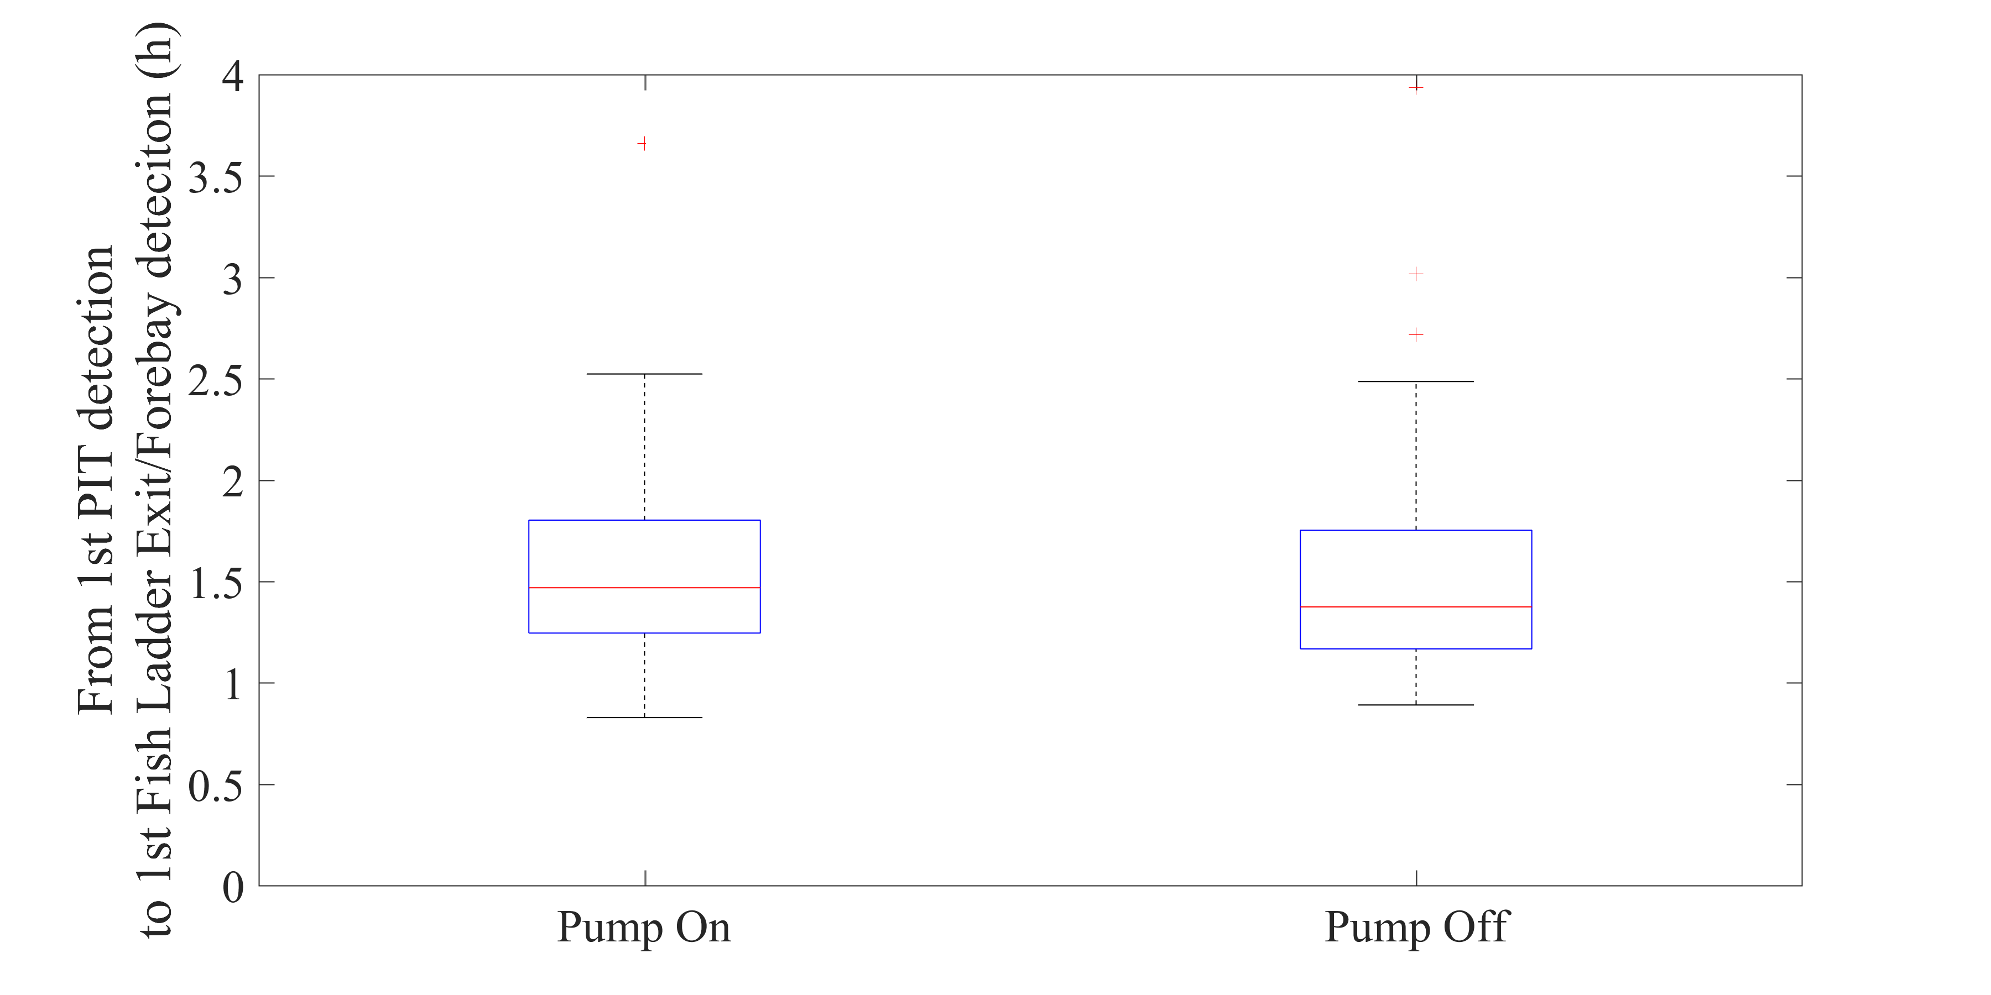
Temperature Reduction System Pump On vs. Off - Travel Time from PIT Detection to Forebay

Slide 31
Conclusions
The acoustic telemetry receivers deployed in the LGS tailrace resulted in high detection efficiency and provide good tracking results
More fish experienced fallback during 2018 (9.8%) compared to the 2008 (3.9%) and 2013 (7.5%) studies.
A majority (62%) of fish were first detected approaching the LGS tailrace along the north shore.
Slightly over half of the fish utilized the north shore fish ladder entrance, and just under half used the south powerhouse entrance. Only 3 (1%) fish used the north powerhouse entrance.
  In previous studies the north powerhouse entrance was always the least used, but the percentages were significantly higher (9% and 16%).
With higher proportions of spill this year, fish took more time to enter the LGS fish ladder.
In this study a larger percentage of fish reached the LGS tailrace than the previous studies, and of those fish a slightly higher percentage passed LGS.
30% spill treatments helped fish to enter the fish ladder and pass LGS. A higher percentage of tagged fish (40 – 65%) was observed entering the fish ladder at the 30% spill level than any other spill level.
When spill level was at 35 – 40%, about 30 – 50% of tagged fish were observed entering the fish ladder.
When spill level was at 45% and above, less then 20% of tagged fish were observed entering the fish ladder.
No difference was detected in travel time from being PIT detected to exiting into the forebay when the temperature reduction system pump was on or off.

Slide 32
Acknowledgments
Funding support:
  US Army Corps of Engineers, Walla Walla District
U.S. Army Corps of Engineers:
  Derek Fryer, Chris Pinney, Scott St. John, Rick Weis, Ryan Laughery, Martin Ahmann
Pacific Northwest National Laboratory:
  Jun Lu, Aljon Salalila, Jarod Cable, Sam Harding, John Stephenson, Kyle Larson, Kate Deters, Bernardo Beirao, Jacqueline Wells, Ryan Ekre, Brian Bellgraph, Shon Zimmerman
U.S. Department of Energy for the funding of related technology development

Slide 33
For additional information about JSATS:
http://jsats.pnnl.gov

